Slide 1

Hospital Management System
The Hospital Management System (HMS) is a comprehensive web application designed to streamline hospital operations, improve patient care, and enhance overall efficiency. Leveraging the latest technologies, the HMS addresses key challenges faced by hospitals, including appointment scheduling, medical record management, staff scheduling, and pharmacy operations.

Slide 2
Centralized Patient Records
Secure Access
Improved Diagnosis
Reduced Errors
The HMS provides doctors with secure, role-based access to patient medical records, allowing them to efficiently update and retrieve critical information.
By having immediate access to a patient's complete medical history, doctors can make more informed diagnoses and provide better-tailored treatment plans.
The centralized medical record system helps eliminate the risk of lost or misplaced files, reducing the potential for medical errors and improving overall patient safety.

Slide 3
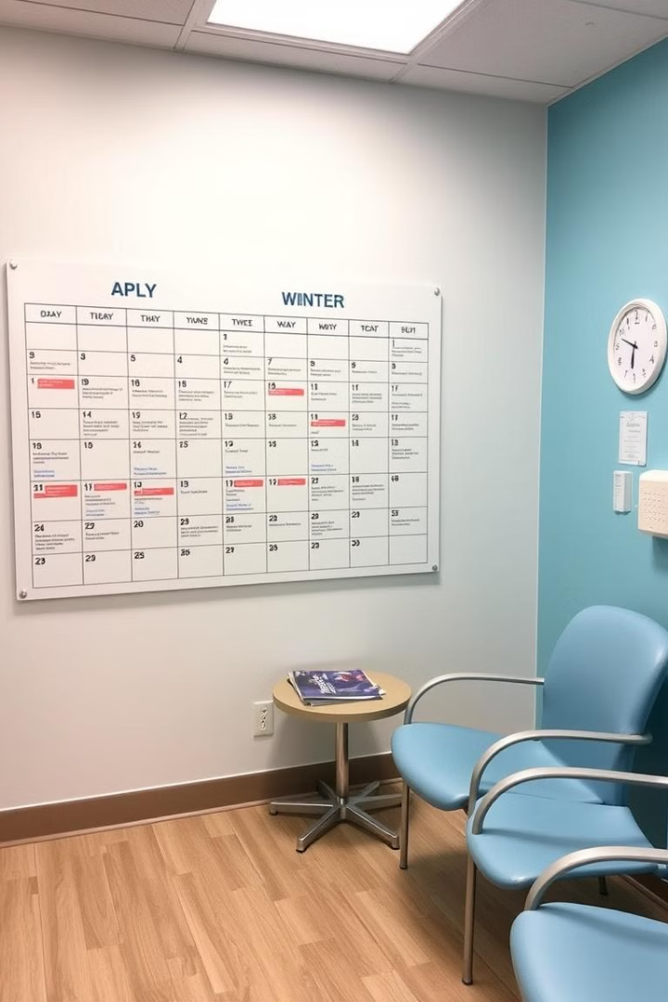
Streamlined Appointment Scheduling
1
Booking Appointments
Patients can easily book appointments through the HMS, with the system automatically preventing conflicts and overbookings.
2
Managing Schedules
Administrators and doctors can efficiently manage appointment schedules, ensuring optimal utilization of resources and minimizing wait times for patients.
3
Automated Notifications
Patients receive timely email or SMS reminders for their upcoming appointments, reducing the likelihood of missed visits.

Slide 4

Optimized Staff Management
Efficient Scheduling
The HMS allows administrators to manage and optimize staff schedules based on availability, ensuring the right mix of doctors, nurses, and other personnel to meet the hospital's needs.
Reduced Shortages
By effectively managing staff schedules, the system helps prevent staffing shortages or overstaffing, improving operational efficiency and patient care.
Improved Collaboration
The centralized staff management system facilitates better communication and collaboration among healthcare professionals, enhancing the overall quality of patient care.

Slide 5





Comprehensive Pharmacy Management
Inventory Tracking
Prescription Processing
Dispensing Records
Reporting
Pharmacists can efficiently manage drug inventory levels, ensuring the availability of necessary medications and reducing the risk of stockouts.
The system allows pharmacists to receive and process prescriptions electronically, streamlining the medication dispensing process.
The HMS tracks all medication dispensing activities, providing pharmacists with a comprehensive view of prescription history and usage patterns.
Detailed reports on pharmacy operations, including stock levels, prescription trends, and medication errors, help identify areas for improvement.

Slide 6
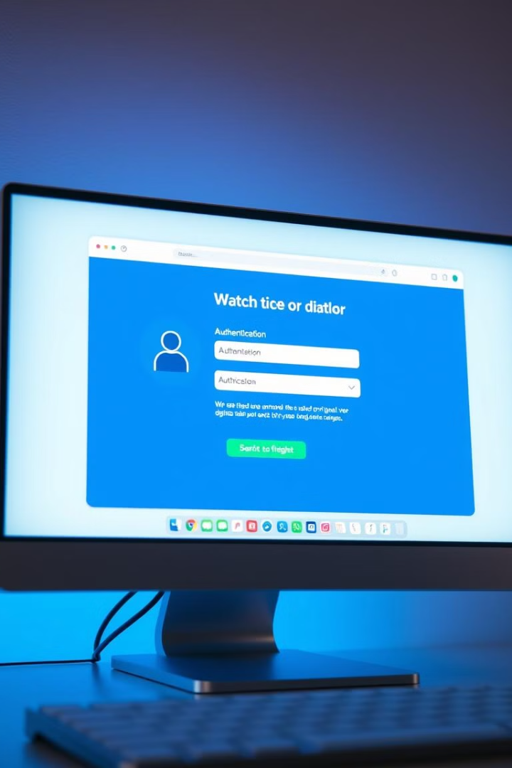
Secure User Authentication
1
Role-Based Access
The HMS implements a robust user authentication system with role-based access control, ensuring that patients, doctors, pharmacists, and administrators can only perform actions relevant to their respective roles.
2
Data Privacy
By restricting access to sensitive patient information and hospital operations, the system helps maintain the confidentiality and integrity of data, in compliance with healthcare regulations.
3
Audit Trails
The authentication system tracks all user activities, providing a comprehensive audit trail that can be used to monitor system usage and identify any potential security breaches.

Slide 7




Automated Notifications
Appointment Reminders
Patients receive timely email or SMS notifications for their upcoming appointments, reducing the likelihood of missed visits.
Prescription Refills
The system automatically sends reminders to patients when their prescriptions are due for a refill, ensuring they never run out of their medications.
Improved Communication
The notification system enhances communication between the hospital and patients, leading to better engagement and improved overall patient satisfaction.

Slide 8

Deployment and Support
Cloud Hosting
The HMS will be deployed on a cloud platform, such as Azure or AWS, ensuring scalability, reliability, and easy maintenance.
Continuous Integration
A robust CI/CD pipeline will be implemented to automate the deployment process, enabling seamless updates and bug fixes.
Technical Support
Comprehensive technical documentation and user guides will be provided, along with dedicated support channels for users to address any issues or questions.

Slide 9

Prototype
The prototyping stage is a crucial step in the design process, allowing designers to explore and refine their ideas before moving forward. This series of images showcases the iterative nature of prototyping, with various shapes and forms representing the different stages of development.

Slide 10
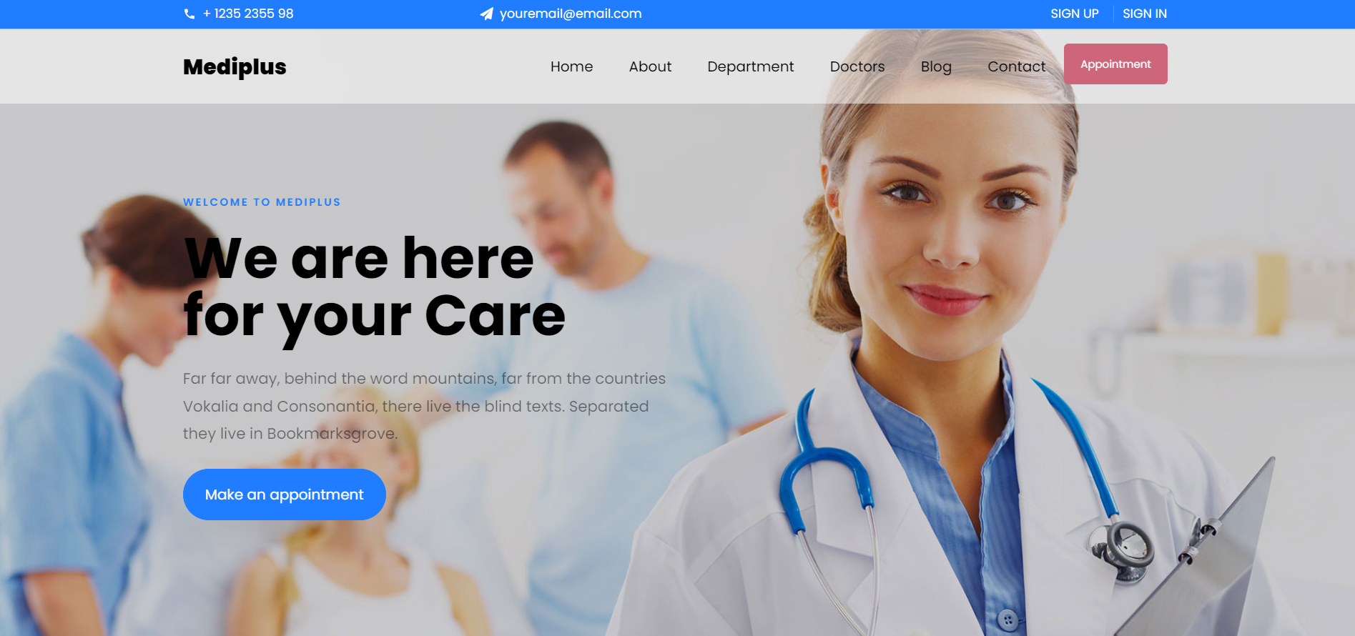

Slide 11
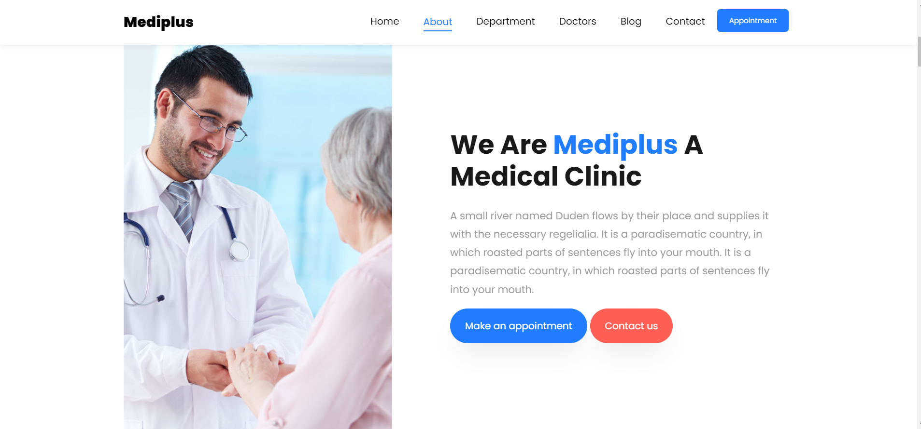

Slide 12
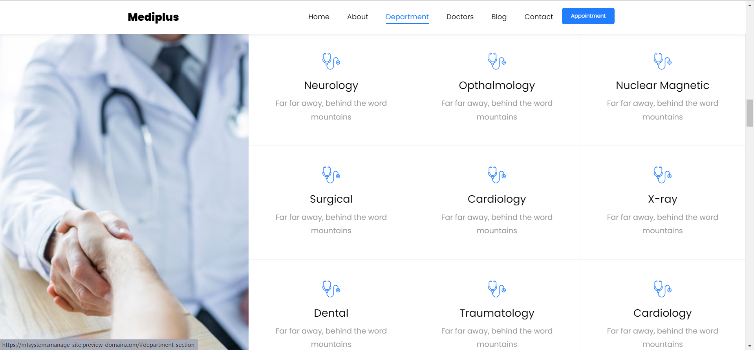

Slide 13
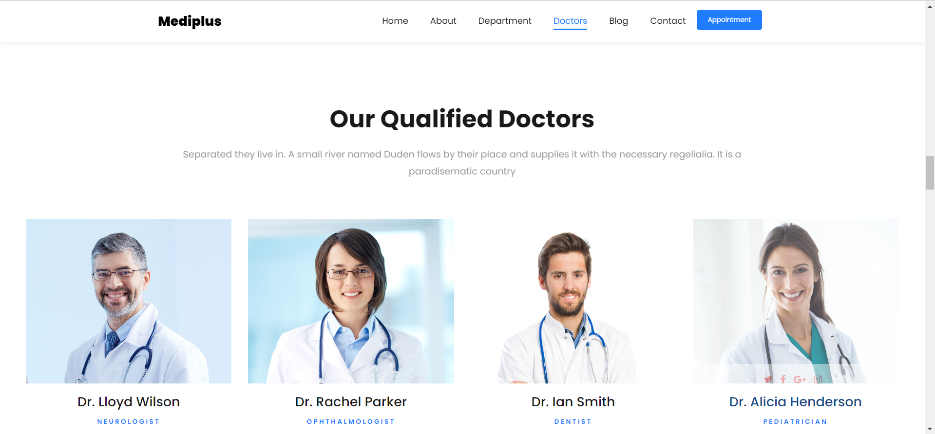

Slide 14


Slide 15
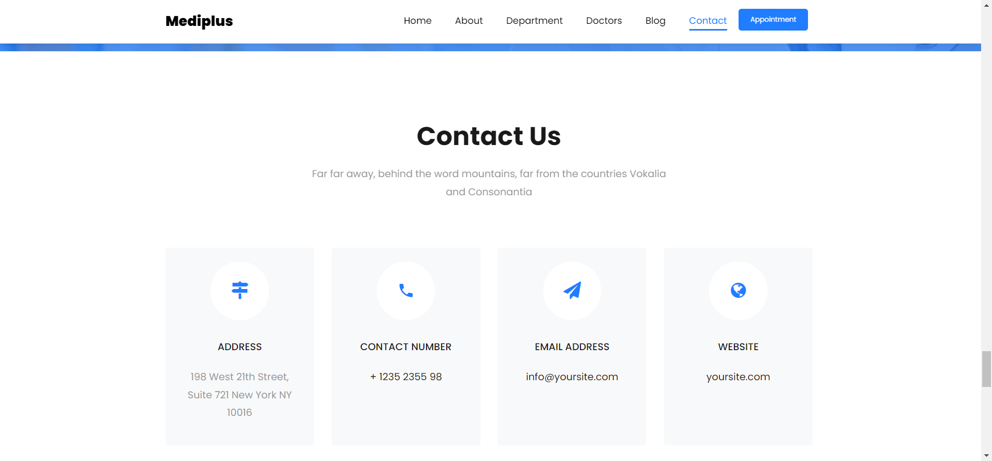

Slide 16
